Slide 1

Evaluating LLM Output Quality BLEU, ROUGE, and
Human Eval
Present By
PRIYA BHARATHI B
B.Tech IT

Slide 2

Large Language Model
Large Language Models (LLMs) ->ChatGPT, Gemini, and Claude are capable of generating human-like text for tasks like translation, summarization, question answering, and content creation. However, simply generating text is not enough we need to evaluate how good and reliable that text is.
LLM evaluation refers to the process of measuring the quality, accuracy, and usefulness of the text produced by a language model. It helps determine how closely the model’s output matches human expectations or reference outputs.

Slide 3
Types of LLM Evaluation
Automatic Evaluation Metrics
Human Evaluation
Algorithm-based measures such as
  BLEU -Bilingual Evaluation Understudy
  ROUGE-Recall-Oriented Understudy for Gisting Evaluation
which compare generated text with reference text.
Qualitative assessment by human judges focusing
  Meaning
  Coherence
  Relevance
  Correctness
  Fluency / Grammar
  Overall quality

Slide 4
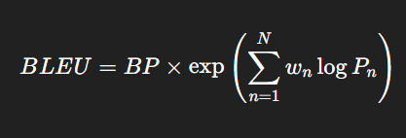
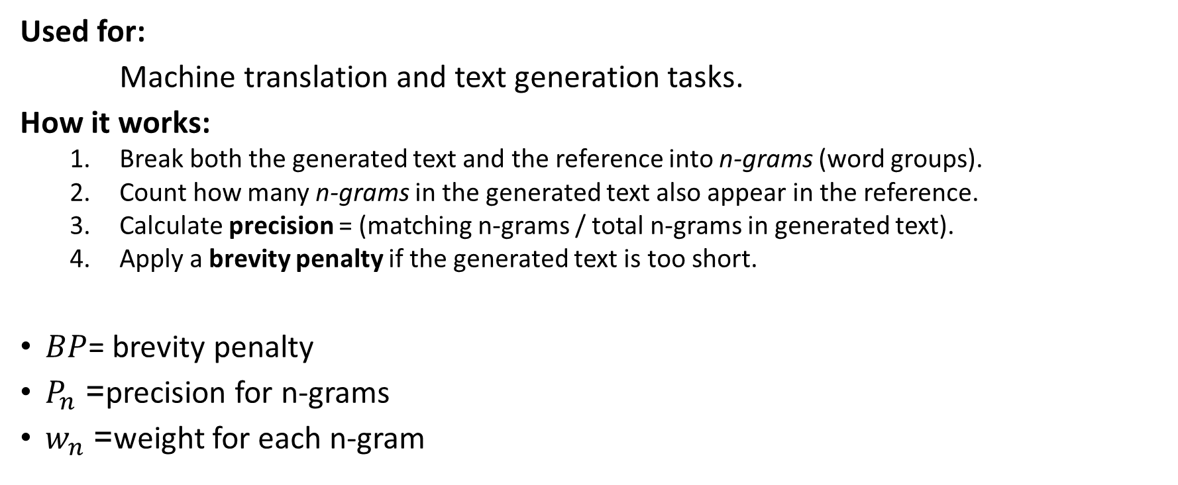
BLEU (Bilingual Evaluation Understudy)
Used for:
Machine translation and text generation tasks.
How it works:
  Break both the generated text and the reference into n-grams (word groups).
  Count how many n-grams in the generated text also appear in the reference.
  Calculate precision = (matching n-grams / total n-grams in generated text).
  Apply a brevity penalty if the generated text is too short.
$BP$= brevity penalty
$P_{n}$= precision for n-grams
$w_{n}$= weight for each n-gram

Slide 5
Example:
Reference: “The cat is on the mat.”
Generated: “The cat sits on the mat.”
Overlapping words: “The”, “cat”, “on”, “the”, “mat”
BLEU score ≈ 0.7 (good overlap)
BLEU score → higher overlap = higher BLEU.
Limitation:
  It focuses on exact word overlap, not on meaning or fluency.
  So, two sentences with the same meaning but different words may get a low BLEU score.

Slide 6
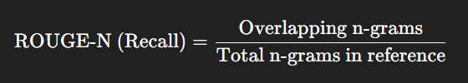
ROUGE (Recall-Oriented Understudy for Gisting Evaluation)
Used for: Summarization and text generation.
focuses on recall — how much of the important information from the reference text appears in the generated text.
Steps:
1.Tokenization
2.Count Overlaps
3.Compute Recall
4.Calculate Rouge Variants

Slide 7
Examples:
Reference Summary:
“The Prime Minister announced a new economic policy focusing on job creation and renewable energy.”
Generated Summary:
“The Prime Minister introduced an economic plan to increase jobs and promote green energy.”
Key : Prime Minister, economic policy/plan, job creation, renewable/green energy → all appear.
Even though wording differs, important content is preserved → High ROUGE score.
Reference Summary:
“The company reported record profits this quarter due to increased sales.”
Generated Summary:
“Sales have dropped, leading to a loss this quarter.”
Explanation:
Different meaning and no overlapping key phrases — Low ROUGE score, because content mismatch.

Slide 8
ROUGE Variants:
ROUGE-1: unigram (word) overlap
ROUGE-2: bigram (two-word sequence) overlap
ROUGE-L: longest common subsequence
ROUGE-S: skip-bigrams (allows gaps) explain
Examples:
Reference → “The cat is on the mat”
Generated → “The cat lies on the mat”

Slide 9

Human evaluation
Human evaluation means real people (often experts or crowd workers) read both the system-generated text and sometimes the reference text, and judge the quality based on specific criteria.
Unlike ROUGE (which just counts word overlap), human evaluators can understand meaning, context, and tone things automated metrics can’t fully capture.

Slide 10
Common Criteria for Human Evaluation in Summarization
Fluency: Is the summary grammatically correct and easy to read?
Coherence: Does the summary flow logically from one sentence to the next?
Informative: Does it include the key points from the original text?
Relevance: Are all details important and related to the topic?
Conciseness: Is it short yet complete (no redundancy)?
Factual consistency: Are the facts correct compared to the source text?

Slide 11
How Human Evaluation Works (Step-by-Step)
Sample Selection:
Choose a set of documents and their summaries (system + reference).
Design Evaluation Form:
Create a rating form — usually with a Likert scale (1–5) or pairwise comparison.
Example:
  1 = Poor
  5 = Excellent
Human Raters:
Recruit multiple human judges (to avoid bias).
Scoring:
Each summary gets an average score across criteria and raters.
Analysis:
Compare systems based on average human scores.

Slide 12
Example:
Original article:
“Apple released its new iPhone 16 with advanced AI features at an event in California.”
Summary A (System 1):
“Apple introduced the iPhone 16 with new AI capabilities.”
Summary B (System 2):
“Apple held an event in California.”
In this example, Human evaluation shows Summary A is much better — even if both might get similar ROUGE scores.
Criteria | Summary A | Summary B
Fluency | 5 | 5
Completeness | 5 | 2
Relevance | 5 | 3
Conciseness | 5 | 5
Overall | 5.0 | 3.75

Slide 13
Comparison Table: BLEU vs ROUGE vs Human Evaluation
Aspect | BLEU | ROUGE | Human Evaluation
Type | Automatic | Automatic | Manual (done by people)
Focus | Precision – how much generated text matches the reference | Recall – how much important content from the reference is covered | Meaning, fluency, coherence, and factual accuracy
Basis | n-gram overlap | n-gram, longest common subsequence, skip-bigrams | Human understanding and judgment
Meaning Understanding | No | No | Yes
Common Use | Machine Translation | Text Summarization | Any NLP task needing quality assessment
Speed | Fast and automatic | Fast and automatic | Slow and time-consuming
Accuracy | Quantitative but limited | Quantitative but limited | Most accurate and reliable

Slide 14

Thank You..

